Slide 1
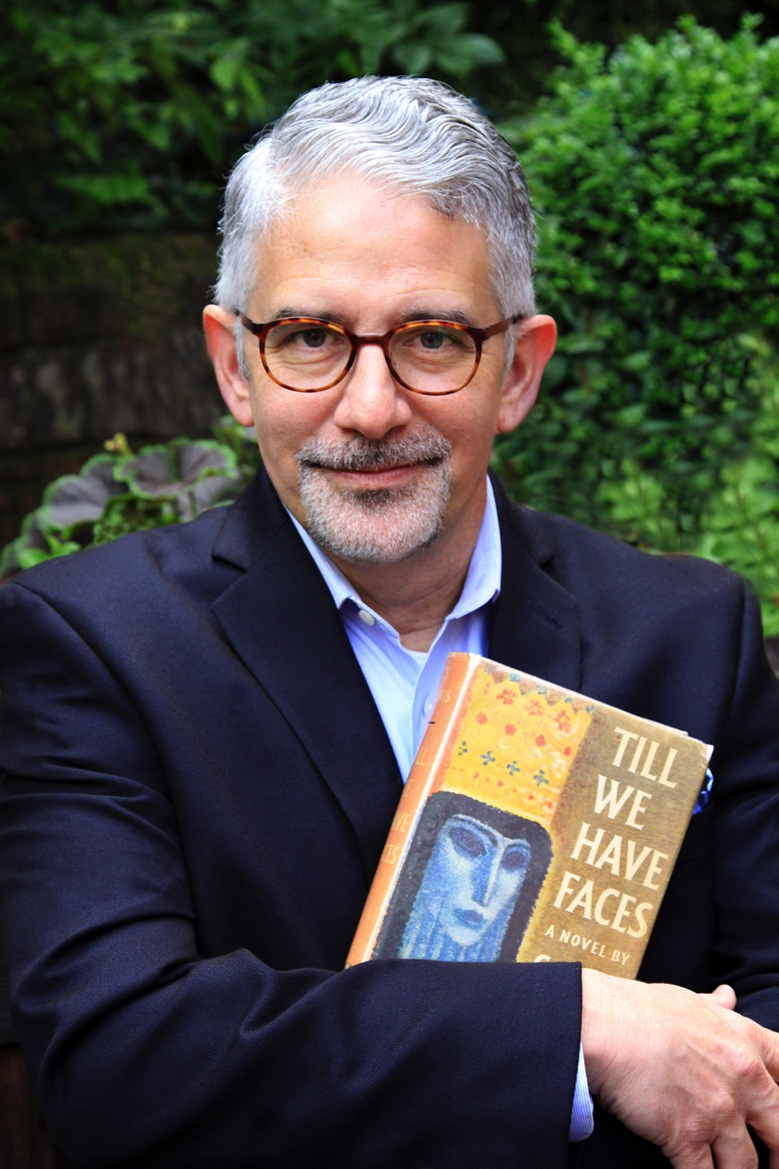
C. S. Lewis and the Myth of Love: (Un)veiling the Mysteries of Till We Have Faces October 11, 7:00 PM Belin Chapel, HBU andrewlazo.com
Distinguished Inklings Scholar Andrew Lazo

Slide 2
Distinguished Inklings Scholar Andrew Lazo

Slide 3
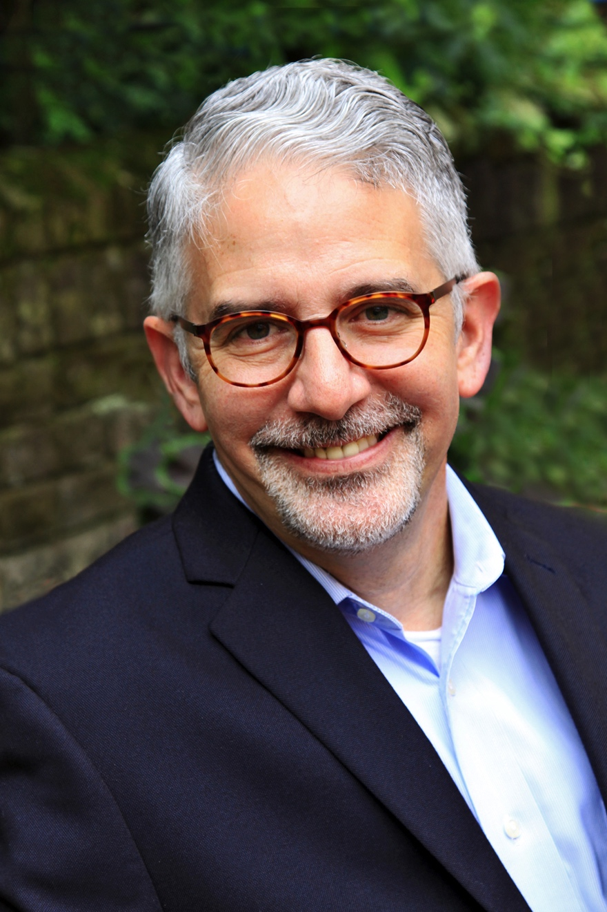
Distinguished Inklings Scholar Andrew Lazo

